Slide 1
TEXT SUMMARIZATION USING EXTRACTIVE UNSUPERVISED METHOD WITH PYTHON
MINOR PROJECT PRESENTATION
DOMAIN – TEXT MINING

Slide 2
Hello !
We are
Vishant Kumar (35696302715),
Nitika Katyal (00496302716),
Amit Lathwal (60296302715)and
Shivani (03896302715).
We are from CSE-E 7th Semester to give presentation on our minor project on
Text Summarization using Fuzzy Logic

Slide 3
CONTENTS
Objective
Problem Statement
Why do we need it ?
Introduction
Approaches of data mining
System Design
Implementation of Algorithm and Libraries
Snapshots of Project
Slides
4
5
6
7
8-12
13-15
16-17
18-19

Slide 4

OBJECTIVE
1. Use best combination of minimum features in feature extraction.
2. Integrate lexical chaining to capture semantic meaning or the central theme of the document achieving cohesiveness in the summary.
3. To capture correlation of sentences and make the best summary of the document.
4. The summary generated should contain the significant information along with the topic coverage which quickly enables the user to quickly comprehend vast amount of information.

Slide 5
PROBLEM STATEMENT
An efficient domain-specific Text summarization technique using Knowledge-base and combined Statistical & Linguistic methods

Slide 6
WHY DO WE NEED IT ?
In this new era, where tremendous information is available on the internet, it is most important to provide the improved mechanism to extract the information quickly and most efficiently.
It is very difficult for human beings to manually extract the summary of a large documents of text. So, there is a problem of searching for relevant documents from the number of documents available, and absorbing relevant information from it. In order to solve the above two problems, the automatic text summarization is very much necessary.

Slide 7
INTRODUCTION
Text summarization has become a necessary and efficient tool for interpreting huge amount of digital information. The text summarization system under discussion makes use of fuzzy logic approach to generate the summary. It is a mathematical tool used for dealing with uncertainty, imprecision, ambiguity and vagueness. Fuzzy logic is a form of many-valued logic that deals with approximate reasoning rather than fixed and exact reasoning.
Fuzzy logic is a mathematical model in which truth can be partial i.e. it can have value between 0 and 1 as compared to traditional binary logic where variables have only two values i.e. 0 or 1. Fuzzy logic is used to handle the concept of partial truth where its truth value ranges between completely true and completely false. For e.g. consider a variable such as age which may have a non-numeric value such as young or old. Such variables are called linguistic variables.

Slide 8
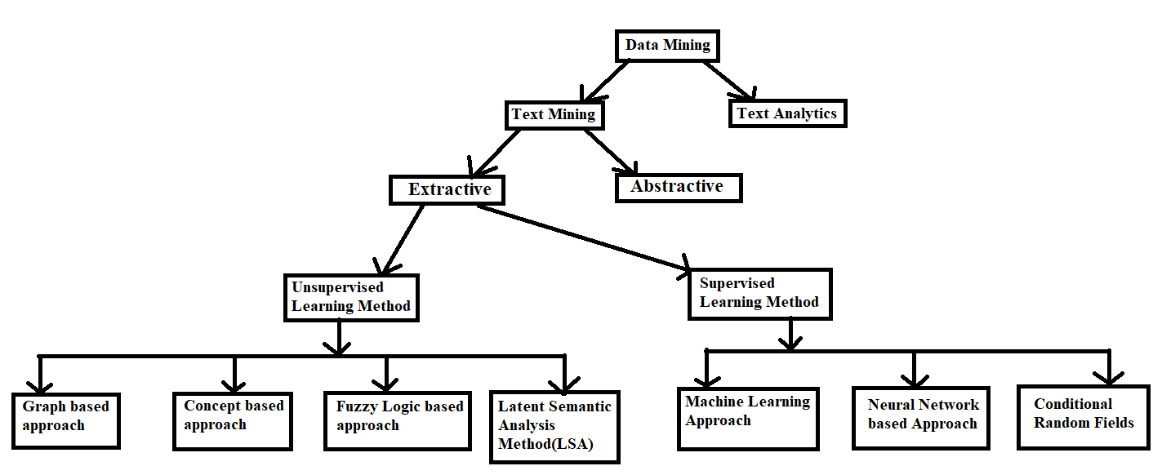
APPROACHES OF DATA MINING

Slide 9

Generally, there are two approaches of text summarization:
Extractive method:
It work by selecting a subset of existing words, phrases, or sentences in the original text to form the summary.
Abstractive method:
It build an internal semantic representation and then use natural language generation techniques to create a summary.

Slide 10
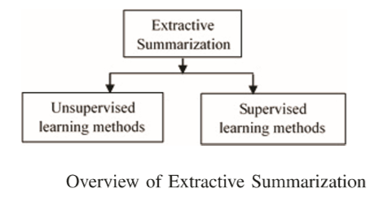
EXTRACTIVE METHOD OF TEXT SUMMARIZATON

Slide 11
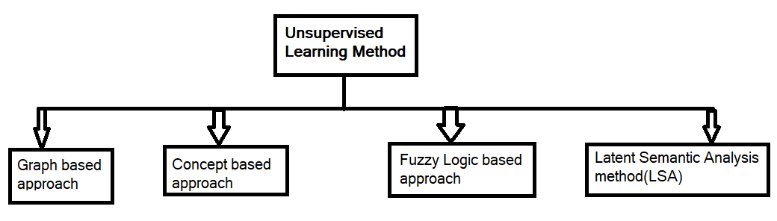
The unsupervised approaches do not need human summaries (user input) in deciding the important features of the document, it requires the most sophisticated algorithm to provide compensation for the lack of human knowledge. [1] Unsupervised summaries provide a higher level of automation compared to supervised model and are more suitable for processing Big Data. Unsupervised learning models have proved successful in text summarization task. [1]
UNSUPERVISED LEARNING

Slide 12
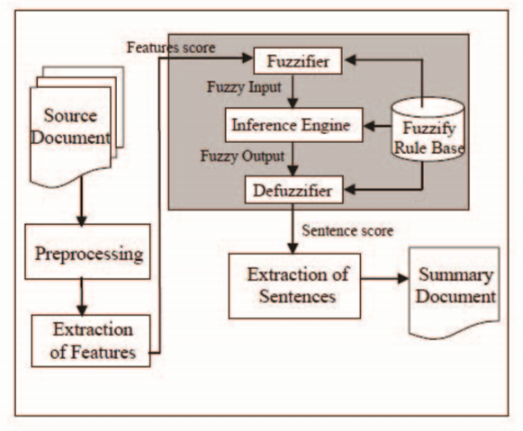
Fuzzy logic based approach
Fuzzy Logic is a way of reasoning that resembles with the human reasoning which based on degrees of truth rather than the usual true or false (1 or 0) Boolean logic. . A value from zero to one is obtained for each sentence in output based on feature contained in sentence and rules defined in a knowledge base.
The textual characteristics input of Fuzzy logic approach are sentenced length, sentence similarity etc which is later given to the fuzzy system.
The fuzzy logic approach mainly contains four components: defuzzifier, fuzzifier, fuzzy knowledge base and inference engine.
fuzzy logic approach is used for automatic text summarization which is the initial step , the text document is pre-processed followed by feature extraction(Title features, Sentence length, Sentence position, Sentence-sentence similarity, term weight, Proper noun and Numerical data.
The summary is generated by ordering the ranked sentences in the order they occur in the original document to maintain coherency.

Slide 13
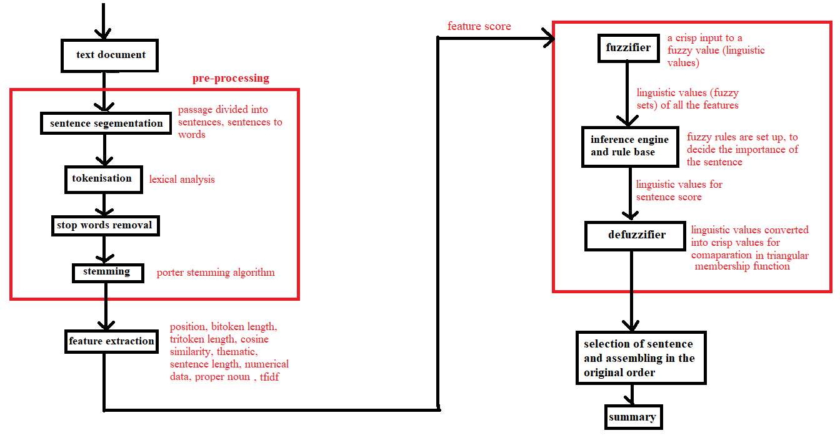
SYSTEM DESIGN
[1]

Slide 14

The system design in figure illustrates various models used. It uses pre-processing on the input document, feature extraction, fuzzification, rule base engine, and defuzzification and lastly generation of summary.
a. Pre-Processing Steps :
Segmentation
Tokenization
Elimination Stop-words
Stemming
b. Featue Extraction :
Sentence Positon
Bitoken
Tri token
Cosine similarity
Thematic Words
Sentence length
Numerical data
Term frequency – inverse sentence frequency

Slide 15
c. Fuzzy Logic System :
Fuzzifier
Rule Base
Inference Engine
Defuzzifier
d. Document Summary

Slide 16

Implementation of Algorithms & Libraries
NLTK : Natural Language Toolkit : The NLTK, is a suite of libraries and programs for symbolic and statistical Natural Language Processing. NLTK is intended to support research and teaching in NLP or closely related areas, including empirical linguistic, cognitive science, artificial intelligence, information retrieval, and machine learning.
RAKE –NTLK : Rapid Automatic Keyword Extraction : RAKE short for Rapid Automatic Keyword Extraction algorithm, is a domain independent keyword extraction algorithm which tries to determine key phrases in a body of text by analyzing the frequency of word appearance and its co-occurance with other words in the text. Rapid Automatic Keyword Extraction (RAKE), an unsupervised, domain-independent, and language-independent method for extracting keywords from individual documents.

Slide 17
VSM : Vector Space Model : Vector space model or term vector model is an algebraic model for representing text documents (and any objects, in general) as vectors of identifiers, such as, for example, index terms. It is used in information filtering, information retrieval, indexing and relevancy rankings. Its first use was in the SMART Information Retrieval System. Documents and queries are represented as vectors. If words are chosen to be the terms, the dimensionality of the vector is the number of words in the vocabulary (the number of distinct words occurring in the corpus). Vector operations can be used to compare documents with queries
TF-IDF : Term Frquency-Inverse Document Frequency : In information retrieval, tf–idf or TFIDF, short for term frequency–inverse document frequency, is a numerical statistic that is intended to reflect how important a word is to a document in a collection or corpus. It is often used as a weighting factor in searches of information retrieval, text mining, and user modeling. The tf–idf value increases proportionally to the number of times a word appears in the document and is offset by the number of documents in the corpus that contain the word, which helps to adjust for the fact that some words appear more frequently in general..

Slide 18
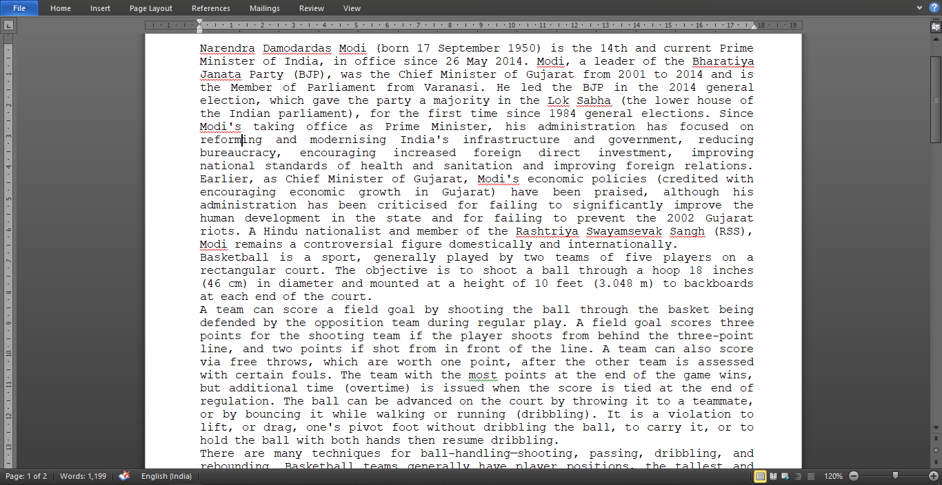
Snapshots of Project INPUT OF TXT DOCUMENT

Slide 19
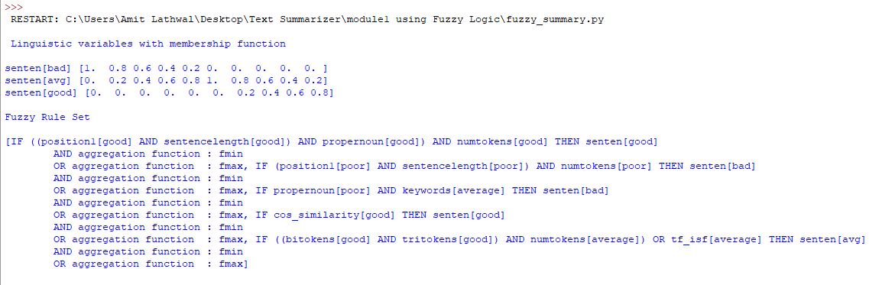
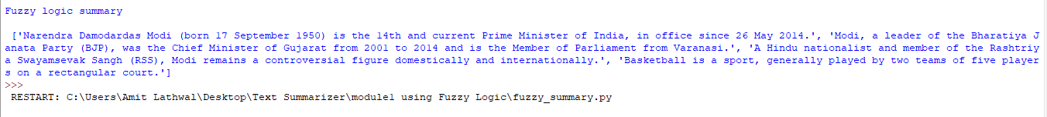
OUTPUT SUMMARY

Slide 20

Want big impact?
Use big image.
Thanks !
Any questions ?

